Slide 1
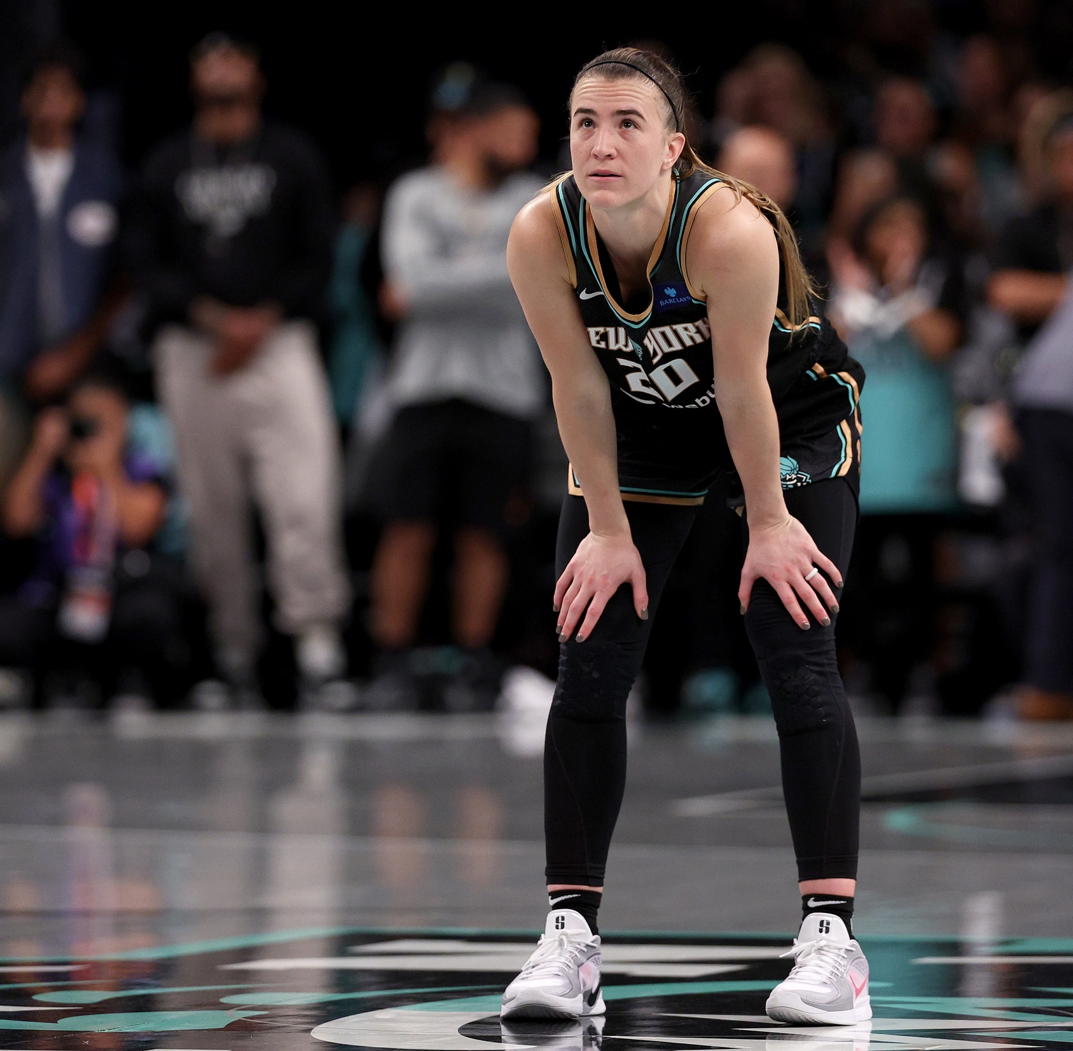

Slide 2
TEACHER INFORMATION
Learning outcome
  By the end of the activity, students will be able to:
    Describe the effects of high-pressure situations.
    Identify ways of preparing for a high-pressure situation or important event.
Overview
  The following slides provide a starter, main and plenary activities that encourage students to develop and apply strategies to mentally prepare themselves for high pressure situations in all areas of their lives, inspired by how NBA players mentally prepare for high pressure games.
Recommended age group
  Students aged 11–16 in UK schools.
Duration
    20 minutes
Resources
    Computer / projector/ screen with audio to play video.
    Printed copies of slide 9 (one per student or pair).
Delivery suggestions
  These activities can be used in a variety of settings to best suit your school, for instance in tutor groups / form-time to help students build the skills they need for future success or embedded into classroom PSHE or GCSE PE lessons.
Preparation
    Choose your delivery option.
    Review the slides and identify if/how you will need to adapt them for your students.
    Print copies of the ‘preparing for an event’ handout for students to read and complete.
Gatsby benchmarks
  The NBA in the Classroom resources can help schools meet the Gatsby benchmarks guidance for careers education.
    4. Linking curriculum learning to careers.

Slide 3
CURRICULUM LINKS
England
  PSHEA Guidelines (11–16)
  Students should have the opportunity to learn:
  KS3
    H1. how we are all unique; that recognising and demonstrating personal strengths build self-confidence, self-esteem and good health and wellbeing
    H2. to understand what can affect wellbeing and resilience (e.g. life changes, relationships, achievements and employment)
    H4. simple strategies to help build resilience to negative opinions, judgements and comments
    H5. to recognise and manage internal and external influences on decisions which affect health and wellbeing
    H6. how to identify and articulate a range of emotions accurately and sensitively, using appropriate vocabulary
    H7. mental and emotional health characteristics and strategies for managing these
  KS4
    H2. how self-confidence self-esteem, and mental health are affected positively and negatively by internal and external influences and ways of managing this
    H4. strategies to develop assertiveness and resilience to peer and other influences
    H6. about change and its impact on mental health and wellbeing and to recognise the need for emotional support during life changes and/or difficult experiences
    H7. a broad range of strategies — cognitive and practical — for promoting their own emotional wellbeing, for avoiding negative thinking and for ways of managing mental health concerns
    H8. to recognise warning signs of common mental and emotional health concerns (including stress, anxiety and depression), what might trigger them and what help or treatment is available
  GCSE PE
    Socio-cultural influences and wellbeing in physical activity and sport – Sports psychology/Mental preparation for performance

Slide 4
CURRICULUM LINKS
England/Wales
  BTECH Sport Level 2
  Psychology for Sports Performance
Wales
  Health and Wellbeing Description of Learning (Step 3)
    I can recognise the benefits of being able to focus attention on my perceptions and thoughts and know that I am developing my self-awareness.
    I can self-regulate my emotions in a healthy way using strategies that I have developed.
    I can set appropriate goals.
    I can see the benefits of communicating about feelings as one of a range of strategies which can help promote positive mental health and emotional well-being.
    I can ask for help when I need it from people I trust.
  GCSE PE (Wales)
  Psychology of sport and physical activity – Metal Preparation
Scotland
  Health and Wellbeing Experience and Outcomes (Third)
    I know that we all experience a variety of thoughts and emotions that affect how we feel and behave and I am learning ways of managing them
    I understand the importance of mental wellbeing and that this can be fostered and strengthened through personal coping skills and positive relationships.
    I am developing my understanding of the human body and can use this knowledge to maintain and improve my wellbeing and health.
  National 5 PE (Scotland)
    Skills, knowledge and understanding – Factors impacting on performance/ impact of mental, emotional, social and physical factors
    Skills for learning, skills for life and skills for work – Health and wellbeing/ Emotional well-being
Northern Ireland
  Learning for Life and Work (KS3)
  Students will have the opportunity to:
    explore the different ways to develop self-esteem
    explore the concept of Health as the development of a whole person
    investigate the influences on physical and emotional / mental personal health
    assess personal skills and achievements to date and identify areas of interest and set targets for self-improvement.

Slide 5
TEACHER INFORMATION
Delivery overview and suggested timings: Mental Preparation session 20 minutes
Activity | Overview | Equipment/videos/activity sheets | Timings
Mental Preparation
Starter and introduction –pregame pressure. (slide 8) | Co-create or review ground rules for discussion. Watch video of players preparing for a game and discuss the impact pressure can have on our thoughts, feelings and bodies. | Mental wellbeing video | 8 mins
Main activity – how might people prepare for high pressure situations? (slides 9 – 11) | Ask students to discuss ways people can prepare for high pressure events. Encourage students to consider their own ideas to stretch higher order thinking, before revealing the prompts on slide 11. | Mental preparation activity sheet (slide 10) | 10 mins
Plenary – why is mental preparation important? (slide 12) | Watch the video of NBA players and discuss. |  | 2 mins
Notes:
These timings are suggested only – please adapt these timings to suit your preferred delivery option (i.e. tutor period or PSHE lesson) and available time. Options to extend are included in the notes.

Slide 6
TEACHING MENTAL HEALTH AND EMOTIONAL WELLBEING
Guidance
  Developing students' knowledge, understanding, skills, language, and confidence to seek support for themselves or others should always be the focus. Students should understand when to seek help, what types of support are available, and what might happen if they access this support.
    At the beginning of a lesson, clear 'ground rules' should be established or reinforced, and confidentiality and anonymity discussed.
    While it is essential that students do not disclose personal information during lessons, appropriate support must be identified.
    When learning is distanced, students are better able to engage with and discuss issues relating to mental health. When students are asked to reflect on and share their own experiences, they may feel strong emotions that prevent them from learning or gaining insight. It is therefore safer and more effective to help students to think about someone other than themselves: someone ‘like them’ — for example, a profile young person of about their age, who goes to a school like theirs. Pupils will gain more from discussing questions like ‘what might they think, feel, do?’ and giving advice to characters in the role of a friend, sibling, or classmate.
    It is worth considering how best to finish a lesson, which can be emotionally draining for both students and teacher. Building in a light-hearted activity at the end of the lesson can change the class atmosphere so students are ready for their next lesson. Try to be available afterwards so that if a student has found the lesson distressing or wishes to make a disclosure, they are able to do so.
    Consider using an anonymous question box for students to add any questions that occur to them for follow up in the next lesson.
Safeguarding
  You may not know of any current issues amongst your students but prepare all lessons on the basis that there will be at least one member of the class who is personally affected by the lesson content. Making the lesson safe for that student will help to ensure the lesson is safe for everyone.
    Ensure you are familiar with your school’s safeguarding policy and procedures, including Child Protection and other relevant policies.
    Alert the mental health/wellbeing lead and other relevant staff about the topic you will be covering and encourage them to discuss the lesson content with any students who are accessing support for related issues. It can be helpful to alert parents too, and ensuring they know how to provide appropriate support.
    Give students a chance to withdraw from the lesson if appropriate (without being expected to justify their absence to their peers). Consider how to follow up with the student(s), as this learning may be especially relevant to them.
    Be prepared in case students make a disclosure and inform students that they can approach the teacher separately if there is something they wish to disclose.
    Signpost sources of support before, during and after the lesson.
    Avoid the use of images, language or content which could prove triggering for students more vulnerable to experiencing distress or trauma in relation to the lesson content.
  Additional guidance can be found from the PSHE Association.

Slide 7
SIGNPOSTING FOR TEACHERS
Teaching about mental health may affect teachers personally.
  Before teaching a lesson on mental health, it may be helpful to talk to your line manager or other colleagues about any concerns. You may also be faced with managing disclosures from students, which can take an emotional toll, so it is important that you are supported by colleagues.
  Some recommended sources to develop subject knowledge around teaching mental health and wellbeing topics are:
    PSHE Association – https://pshe-association.org.uk
    NHS – https://mindedforfamilies.org.uk
    Public Health England’s Rise Above Lessons for Schools – https://campaignresources.phe.gov.uk/schools/topics/rise-above/overview
    Young Minds – https://youngminds.org.uk
    Anna Freud – www.annafreud.org

Slide 8

PREGAME PRESSURE
What do you think the players are feeling?
What effects might these feelings have
on their bodies?
Notes:
Starter and introduction (8 minutes)
Involve students in setting ground rules or remind students of them if already established (see https://pshe-association.org.uk/guidance/ks1-4/mental-health-guidance).
Show the video of NBA players waiting to run out onto court. Video link: https://youtu.be/cGLiQagYPLA
Students discuss what they think the players are feeling and the effects this may have on their bodies.
Ask the students to feed back their thoughts and teacher records. For example: they may feeling scared, excited, nervous, bursting with energy or anxious. These feelings might cause their hearts to beat quicker, their minds to be full of racing thoughts, their body parts to shake or twitch, their bodies to sweat more, their muscles to tense, their breathing to quicken or they may feel nauseous.
Ask students to share with each other situations, sport related or otherwise, in which a young person their age might experience similar feelings and effects on their bodies. For example: before an exam or job interview, when meeting someone new or joining a new school, visiting unfamiliar environments or places, moving house, changing or difficult relationships, changes in body due to puberty, fitting in with others, performing or speaking in front of others in the classroom, in plays, debates, sporting events etc.
Take feedback if any student is willing to share with the class. Teacher can run through the example answers above to build on ideas shared by students.
Reinforce that there will be many situations throughout life when any of us might experience these feelings (give some examples) and stress that it is totally normal. Introduce that there are, however, different ways we can prepare ourselves to face such challenging situations.

Slide 9


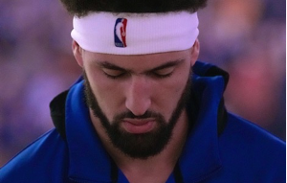

HOW MIGHT PEOPLE PREPARE
FOR HIGH PRESSURE SITUATIONS?
Notes:
Main activity (10 minutes)
Share the handout of questions (see next slide) related to preparing for an important event/high pressure situation and review each question, giving or asking for examples of answers for each using various events/situations as a context, e.g., an exam, sports competition, medical procedure, job interview etc.
Ask the students to choose one potential important event/situation and fill in the second column with their own thoughts in answer to the questions posed, working individually or in pairs or small groups as appropriate.

Slide 10
MENTAL PREPARATION
Think about a common high-pressure event or situation that a young person your age might face.
How could they prepare?
What might someone need to do to prepare themselves ahead
of this event or situation?
What might be their stress triggers and how might
they deal with them?
What might help them stay calm and focussed just before
the event or situation?
What positive phrases or statements could they say to themselves to challenge negative or unhelpful thoughts?
How might they respond when faced with a particular challenge
during the event or situation?
Notes:
Printable slide
Example answers/prompts:
What might someone need to do to prepare themselves for the event/situation?
E.g. get enough sleep, eat healthily, talk to friends, family, teachers or coaches, study or research, practise, distract themselves by doing something they enjoy such as reading, listening to music, watching TV, playing a game, exercising etc.
What might help them stay calm and focused just before the event/situation?
E.g. deep breathing, visualise a positive outcome, create a routine if the situation is reoccurring, focus only on things they can control, distract themselves, accept that a negative outcome can be an opportunity to learn and often is only temporary, listen to motivational music or watch a motivational video clip, replace negative self-talk with positive affirmations, focus on the immediate not the future.
How might they respond when faced with a particular challenge during the event/situation?
E.g. stop and think, take deep breaths, speak to someone, ask for advice or help, move on from a mistake quickly, view the mistake as a challenge, force the mind to focus or refocus, remain composed.
What might be their stress triggers and how might they deal with them (stress busters)?
E.g. Triggers – relationships, body image, feeling overwhelmed, feeling alone or isolated, self-confidence, others’ opinions or comments, the need to impress or make someone proud, feeling underprepared, lack of time, lack of money, lack of support, new situations or environments.
E.g. Busters – talking to a friend, family or teacher, doing something physical, doing something new or different (cook or bake, play a new game), thinking of positive things in their life, helping someone else with something, doing something they enjoy such as reading, listening to music, watching TV, playing a game, exercising etc.
What positive phrases or statements could they say to themselves to challenge negative or unhelpful thoughts?
E.g. I am/ feel…..strong, a good person, capable, liked, loved, skilled, confident, successful, good at, grateful independent etc. OR each day I am getting better, closer to my goals, more prepared, healthier etc.

Slide 11











HOW MIGHT PEOPLE PREPARE FOR
HIGH PRESSURE SITUATIONS?
LOOK AFTER YOUR BODY
VISUALISE SUCCESS
ASK
PLAN
ROUTINE
CHANGE IT UP
TAKE A BREAK
STOP, BREATHE, THINK
LIST THE POSITIVES
DEEP BREATHING
BREAK IT DOWN
CONNECT
Notes:
Main activity
As needed, use the icons on the slides to help prompt students in completing their handout and responding to the questions.
Take examples from the class and summarise / add additional ideas. (Answer prompts below.)
Challenge: In sport, people often talk about the four C's of mental preparation. To improve performance you have to want to do better. The determination to do this is called motivation and the intensity of the feeling arousal. Thinking about the four Cs help athletes maintain the right mindset for success. Introduce the four C's. Ask students to review their suggestions, and the prompts on the slide – which actions support which of the four Cs? (E.g. Planning and taking breaks can aid your commitment and concentration, deep breathing help your control etc.) What other actions could support the four Cs?
Confidence: believe in your own abilities
Concentration: focus on the task
Commitment: continued interest and work rate over time
Control of arousal: managing emotions e.g. anxiety and anger.
Questions and example answers/prompts:
What might someone need to do to prepare themselves for the event/situation?
E.g. get enough sleep, eat healthily, talk to friends, family, teachers or coaches, study or research, practise, distract themselves by doing something they enjoy such as reading, listening to music, watching TV, playing a game, exercising etc.
What might help them stay calm and focused just before the event/situation?
E.g. deep breathing, visualise a positive outcome, create a routine if the situation is reoccurring, focus only on things they can control, distract themselves, accept that a negative outcome can be an opportunity to learn and often is only temporary, listen to motivational music or watch a motivational video clip, replace negative self-talk with positive affirmations, focus on the immediate not the future.
How might they respond when faced with a particular challenge during the event/situation?
E.g. stop and think, take deep breaths, speak to someone, ask for advice or help, move on from a mistake quickly, view the mistake as a challenge, force the mind to focus or refocus, remain composed.
What might be their stress triggers and how might they deal with them (stress busters)?
E.g. Triggers – relationships, body image, feeling overwhelmed, feeling alone or isolated, self-confidence, others’ opinions or comments, the need to impress or make someone proud, feeling underprepared, lack of time, lack of money, lack of support, new situations or environments.
E.g. Busters – talking to a friend, family or teacher, doing something physical, doing something new or different (cook or bake, play a new game), thinking of positive things in their life, helping someone else with something, doing something they enjoy such as reading, listening to music, watching TV, playing a game, exercising etc.
What positive phrases or statements could they say to themselves to challenge negative or unhelpful thoughts?
E.g. I am/ feel…..strong, a good person, capable, liked, loved, skilled, confident, successful, good at, grateful independent etc. OR each day I am getting better, closer to my goals, more prepared, healthier etc.

Slide 12

WHY IS MENTAL
PREPARATION IMPORTANT?
“I focus on the why – from why am I doing this task, to why am I playing basketball. This gives me the motivation to be disciplined, complete the task and be the best that I can...”
- Natalie Achonwa, Minnesota Lynx
Notes:
Plenary / closing assessment (2 minutes)
Share a quote from an WNBA player about the importance of preparation and training / caring for the health of your mind – reinforce that this is something we can all work on, not just when we have a specific event or situation in mind; like other muscles we can all work to strengthen our mental fitness to help us deal with life’s challenges.
Explain to the students that, in the following two sessions, they will be exploring techniques to cope with some of the feelings and emotions discussed today and then look at setting themselves goals to help them achieve what they want to in life even if it involves a high-pressure situation or event.

Slide 13


FIND OUT MORE
  If you are finding things difficult
  or feeling overwhelmed by an upcoming event or situation, it important to speak with a trusted adult at home or in school
  and ask for help or advice.
If you want to find out more about some of the things we’ve discussed today, there are lots of places you could go to find out more.
    Make your mental health a priority: totalhealth.nba.com/
    Find out more about self-care ideas: annafreud.org/on-my-mind/self-care
    More advice for preparing for exams: nhs.uk/mental-health/children-and-young-adults/help-for-teenagers-young-adults-and-students/tips-on-preparing-for-exams
    Find mental wellbeing information and ask questions with the 1:1 online chat service: kooth.com
    Put a question in the 'ask it box'.
Childline:
childline.org.uk/info-advice
or call 0800 1111
Shout: Text 85258
Notes:
Signposting (1 min)
Share this slide with students and remind them that although we can use different techniques to help us prepare for high pressure events and situations, this isn’t always easy – or possible alone – especially if they aren’t feeling their best. Some of the techniques discussed in this session can help us prepare for big events, but if they are feeling low, overwhelmed or worried, they should always speak to a trusted adult.
If things become difficult, they should speak to a trusted adult in school, at home or contact Childline (0800 1111 or www.childline.org.uk) or Shout. Childline runs free telephone helplines for children and young people, while Shout offers free text messaging support – both offer 24/7 services and crisis support.
If anyone is in need of mental health support, speak to the mental health lead in your school or search for a local service at: www.nhs.uk/service-search/mental-health/find-an-urgent-mental-health-helpline

